Slide 1
OUDI
Notes:
OUDI is a oud making shop. They make handmade ouds under demand. It has strong presence in reality, and wants to expand to reach more customer.

Slide 2
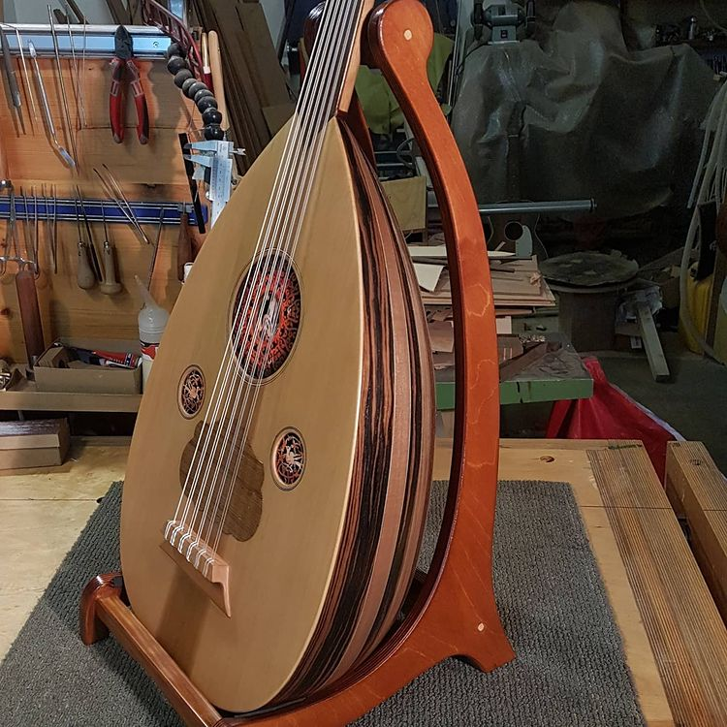
OUDI
Notes:
First, I met my client and we had a very long conversation about his brand personality, and his target people.
My client is a traditional oud maker. He has built a strong identity in his country, and now he wants to expand his project to include the rest of the world through creating a landing page that makes easy for people to discover what he makes

Slide 3
OUDI
What is a landing page?

Slide 4
OUDI
A landing page is a page that has a FOCUSED call to action.

Slide 5
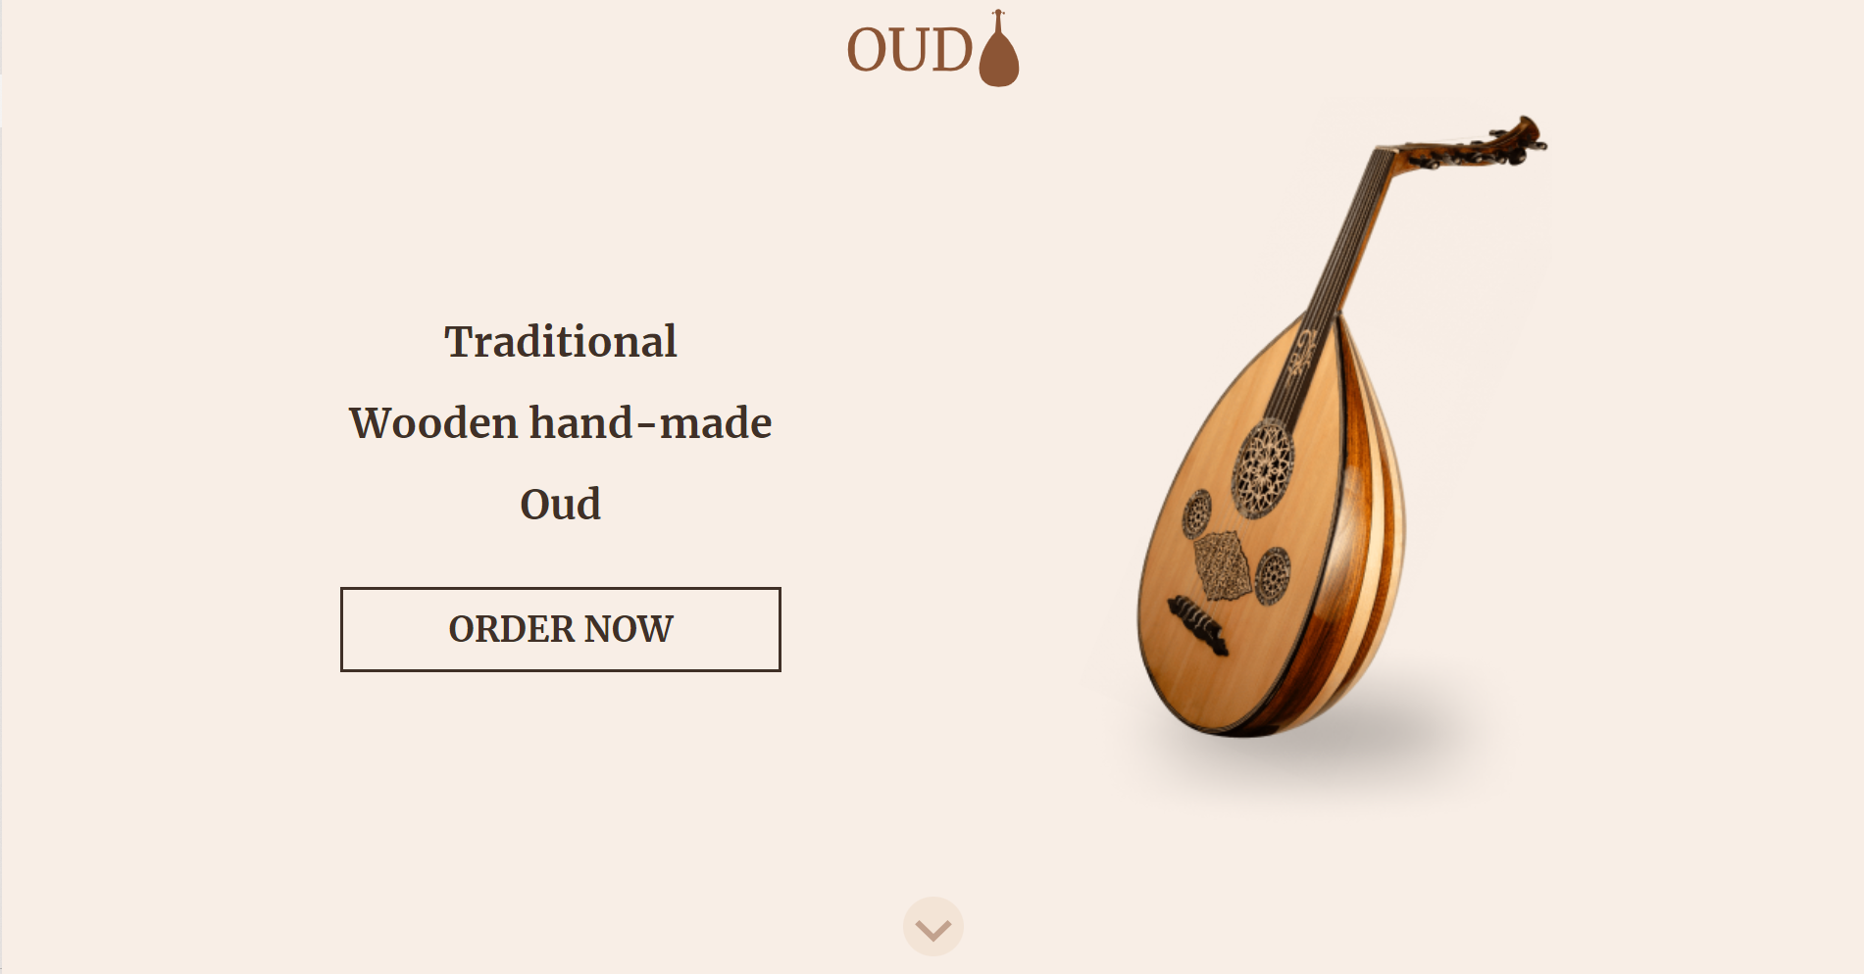
OUDI
Notes:
The example we have arrived at is this page….

Slide 6
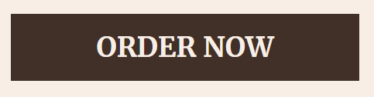

Notes:
In which the call to action is the focus of our landing page. It calls the visitor to order his/her oud through sending an email.

Slide 7
OUDI
The process
Notes:
Well, before all.. I would like to talk to you about the process that we went through in order to come up with the final design of the site.

Slide 8
The process
OUDI
Question:
What do you offer people?
Answer:
Handmade ouds
Notes:
I made sure that I get as much information as I could from him through asking various questions to my client

Slide 9
The process
OUDI
Question:
What is your problem?
Answer:
Limited in my locally. I want to reach more customers.
Notes:
I made sure that I get as much information as I could from him through asking various questions to my client

Slide 10
The process
OUDI
Question:
When did it start?
Answer:
The problem starts with the spread of musical tools made by machines. High competition in my local area, and low prices.
Notes:
I made sure that I get as much information as I could from him through asking various questions to my client

Slide 11
The process
OUDI
Question:
Why other solutions did not work?
Answer:
They have become outdated, and not professional enough for my brand.
Notes:
I made sure that I get as much information as I could from him through asking various questions to my client

Slide 12
The process
OUDI
Question:
What do you need?
Answer:
A professional landing page that represents my brand’s identity.
Notes:
I made sure that I get as much information as I could from him through asking various questions to my client

Slide 13
The process
OUDI
Question:
What do you need?
Answer:
A professional landing page that represents my brand’s identity.
Notes:
I made sure that I get as much information as I could from him through asking various questions to my client

Slide 14
The process
OUDI
Question:
How do you want it?
Answer:
Simple and elegant as my ouds
Notes:
I made sure that I get as much information as I could from him through asking various questions to my client

Slide 15
The process
OUDI
Question:
Who are your potential customers?
Answer:
Musicians, music lovers, artists, traditional goods collectors. 🡺 In other words, those who are interested music and appreciate it.
Notes:
I made sure that I get as much information as I could from him through asking various questions to my client

Slide 16
OUDI
S i m p l e a n d E l e g a n t
Notes:
All the latter answers helped deduce that brand personality of my client is based on Simple and Elegant and easy to access.
The page he wants doesn’t perform any actions, just a simple page that presents the process of making the handmade ouds, and at the end a form through which the interested client can order his/her oud, and discuss the specifications even further.

Slide 17
OUDI
Brainstorming
Notes:
Therefore, we tried to come up with a simple and strong idea for his landing page product presentation. The idea was to make a very..

Slide 18
Brainstorming
OUDI
Clear
Traditional
Simple
Responsive
Concise
Luxurious
Clean
Notes:
simple, traditional, luxurious, responsive, clear, simple, and concise design that meets the clients standards and the customers standards.
These were the main principles that we deduced from our client’s answers

Slide 19
OUDI
Scripting

Slide 20
Scripting
OUDI
Stages of making a oud
1
2
3
4
5
6
7
8
Notes:
The first stage was scripting the process through which the oud gets made. The making of an oud takes more than 40 stages to produce, but we made sure to reduce the number of steps into 8 major steps so that it is not long for the customer to leaf through.

Slide 21
OUDI
Sketching

Slide 22
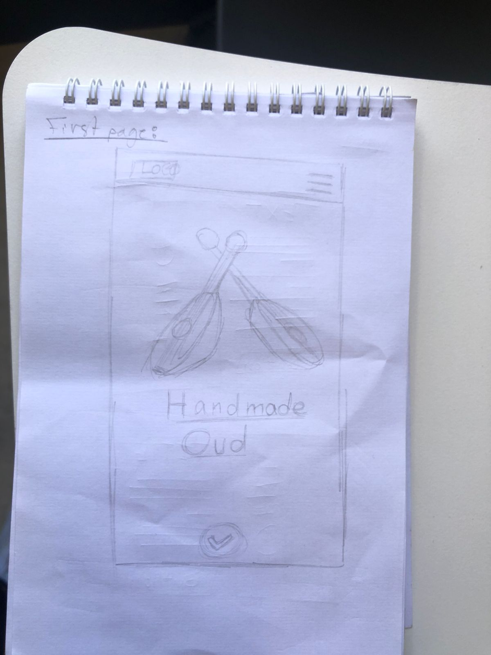
Sketching
OUDI
First Page:
Notes:
Based on the data collected, we made the first sketch that is inspired from https://www.apple.com/iphone-13-pro/ because it is the very very popular that is known of being basic. So based on their presentation of iPhone 13, we tried to make a grid-like presentation of the product. Which comes like this.

Slide 23
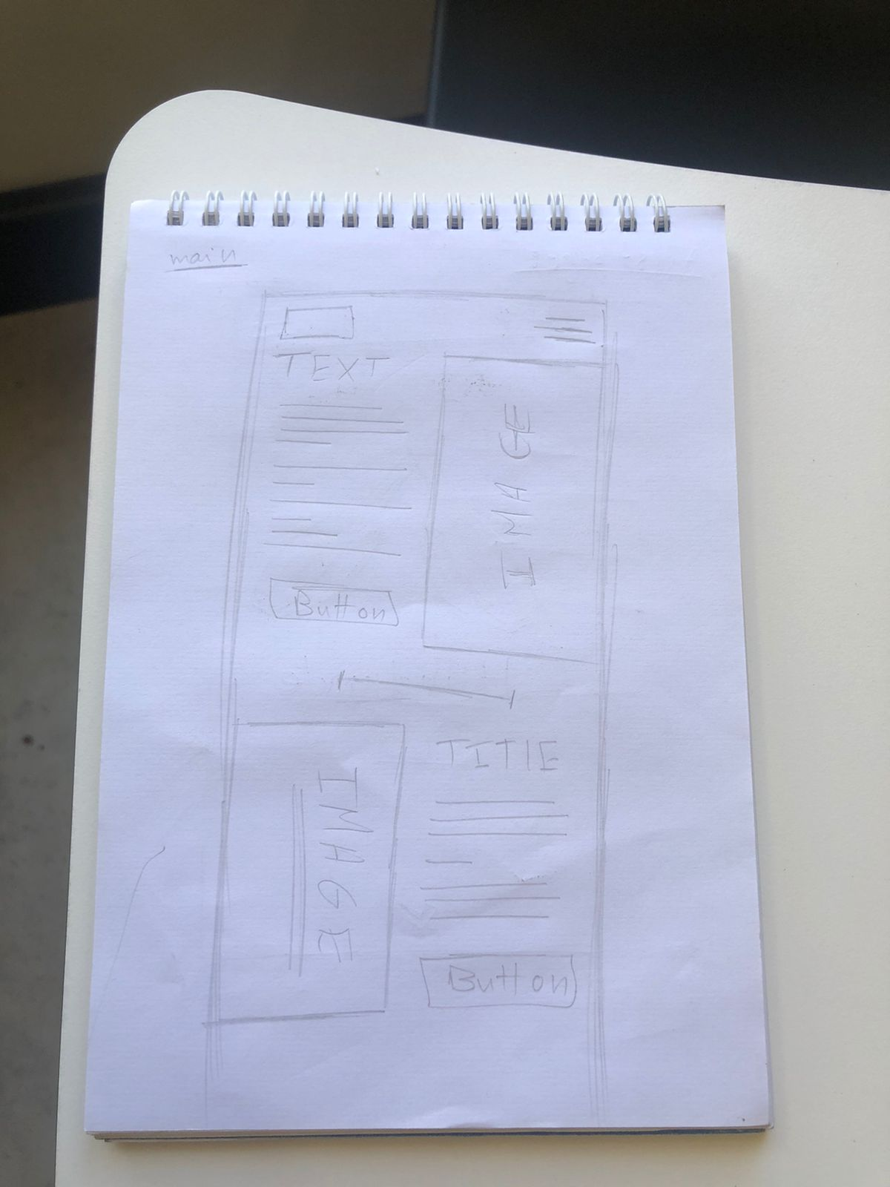
Sketching
OUDI
Main and Nav:

Slide 24
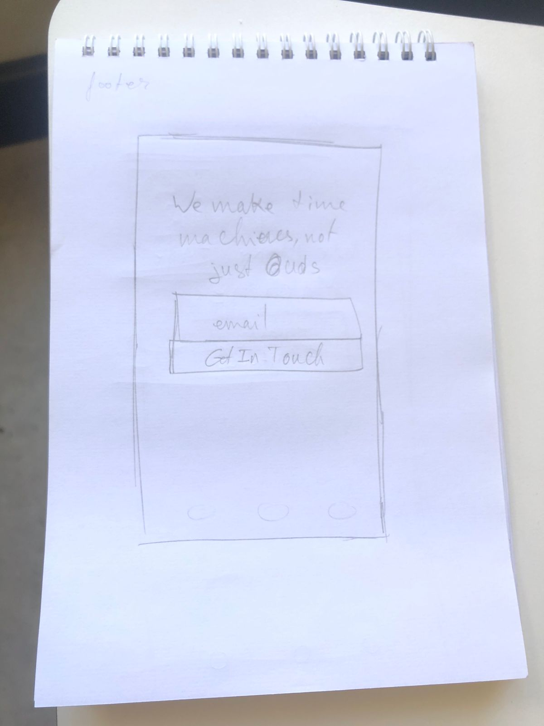
Sketching
OUDI
Footer:

Slide 25
OUDI
Prototype
See here
Notes:
Then, we made sure to visually present how the landing page would look, and so we made a prototype in Figma. With the sketch in mind, we made a simple page. We started by the mobile sketch, because 64% of people in the world access sites through their mobiles. So, after we finished prototyping the mobile version, it was not hard to transform it into the desktop version, or widescreen version.

Slide 26
OUDI
Colours

Slide 27

Colours
OUDI

Slide 28
OUDI
Coding
Notes:
Then we moved to coding the landing page with HTML and CSS. With the right references in hand, the coding part was not hard. We had all the data available: images, fonts, colours, logos, and the prototype.

Slide 29
Coding
OUDI
The first page
Two Call-to-actions
The main part and navigation
Dropdown menu
The footer

Slide 30
Coding
OUDI
@media only screen and (max-width: 900px) {
MyStyles
}

Slide 31
Coding
OUDI
Scroll Snap & Scroll-Behavior
Notes:
GitHub: https://github.com/mouadelamrani/Responsive-Landingpage-Brief
Google Drive: https://drive.google.com/drive/folders/1NboPZdJ_4_l0fM0B-sjJw71LuX_WRqdN?usp=sharing

Slide 32
Coding
OUDI
Interactivity
Notes:
GitHub: https://github.com/mouadelamrani/Responsive-Landingpage-Brief
Google Drive: https://drive.google.com/drive/folders/1NboPZdJ_4_l0fM0B-sjJw71LuX_WRqdN?usp=sharing

Slide 33
Coding
OUDI
Figma: figma.com/file/0oj3gF9K7yP8u5kkI22htJ/Responsive-site-UI?node-id=0%3A1
GitHub: github.com/mouadelamrani/Responsive-Landingpage-Brief
Google Drive: drive.google.com/drive/folders/1NboPZdJ_4_l0fM0B-sjJw71LuX_WRqdN?usp=sharing
Notes:
GitHub: https://github.com/mouadelamrani/Responsive-Landingpage-Brief
Google Drive: https://drive.google.com/drive/folders/1NboPZdJ_4_l0fM0B-sjJw71LuX_WRqdN?usp=sharing

Slide 34
Any question!!
Notes:
OUDI is a oud making shop. They make handmade ouds under demand. It has strong presence in reality, and wants to expand to reach more customer.

